Slide 1
Reading Quiz
APA Chapter 4
5 Questions

Slide 2
APA Results and Discussion Sections
Lecture 10

Slide 3
APA Results

Slide 4
An overview of the results section
In the results section, summarize the collected data and the analysis performed on those data relevant to the discourse that it to follow. Report the data in sufficient detail to justify your conclusions. Mention all relevant results, including those that run counter to expectations. Do not include individual scores or raw data. ... Discussing the implications of the results should be reserved for presentation in the discussion section.
Notes:
Quoted from APA Publication Manual page 32
I’ve bolded certain phrases for emphasis

Slide 5
APA results sections should include
Recruitment and follow-up dates (if applicable)
Participant flow with sample size information for those participants assigned to each condition (if not already described in the Method section)
Evidence that the intervention or manipulation were delivered as intended or checks on the manipulation
Baseline data
Adverse events
Excluded or missing data
Statistics and data analysis
Ancillary analyses, including subgroup and adjusted analyses
  Be sure to indicate which were prespecified (planned at the beginning) and which were exploratory (based on interesting results)

Slide 6
What to report for statistics and data analysis
Report the percentages of missing data if there is any
The type of statistical test performed. Assume that your reader has a professional knowledge of statistical methods. Only justify the appropriateness of a statistical test if its appropriateness is in question.
Significant and non-significant results
P-values for each test (exact p-values preferred)
Effect sizes
Confidence intervals
Test statistic and degrees of freedom
Per-cell sample sizes, observed cell means , and cell standard deviations or pooled within cell variance (if applicable)
Group information (means) by condition (if applicable)

Slide 7
Miscellaneous information
The tense depends on whether you’ve already completed the study (past tense) or are proposing a study to be completed in the future (future tense)

Slide 8
Example
An independent samples t-test was conducted comparing the mischievous actions of those with and without an invisibility cloak. Table 1 reports the results of this analysis. On average, participants with an invisibility cloak (M = 5, SD = 1.65) engaged in more mischievous actions than those without an invisibility cloak (M = 3.75, SD = 1.91). However, this difference was not statistically significant, t(22) = -1.71, p = .10, 95% confidence interval [-2.76, 0.26]. This indicates that there was not a significant difference in the number of mischievous actions engaged in for those with and without an invisibility cloak. This does not support the a priori hypothesis which stated that those participants with an invisibility cloak would engage in more mischievous actions.

Slide 9
APA Discussion

Slide 10
An overview of the discussion section
Here you will examine, interpret, and qualify the results and draw inferences and conclusions from them. Emphasize any theoretical or practical consequences of the results.
Notes:
Quoted from APA Publication Manual page 35

Slide 11
APA discussion sections should include
Whether the original hypotheses were supported
  If your hypotheses were not supported, you can say why you think they weren’t supported based on previous research
Other relevant research
  Describe similarities and differences between your work and the work of others to contextualize, confirm, and clarify your conclusions
Whether the intervention or manipulation was successful
  Barriers to implementing the intervention or manipulation
Limitations
Future research
The importance of your findings
  What is the clinical or practical significance of outcomes
  Is there real-life psychological phenomena which are explained or modeled by the results
  Are applications warranted
Conclusion
Do NOT repeat points you’ve already made
Notes:
Information pulled (sometimes word for word) from APA Publication Manual page 35-36

Slide 12
What to consider for limitations
Sources of potential bias and threats to internal validity
The imprecision of measures
The overall number of tests or overlap among tests
The effect sizes observed
Alternative explanations or confounds
Generalizability or external validity of findings
Statistical power (based on sample size and effect size)
Notes:
Information pulled (sometimes word for word) from APA Publication Manual page 35-36

Slide 13
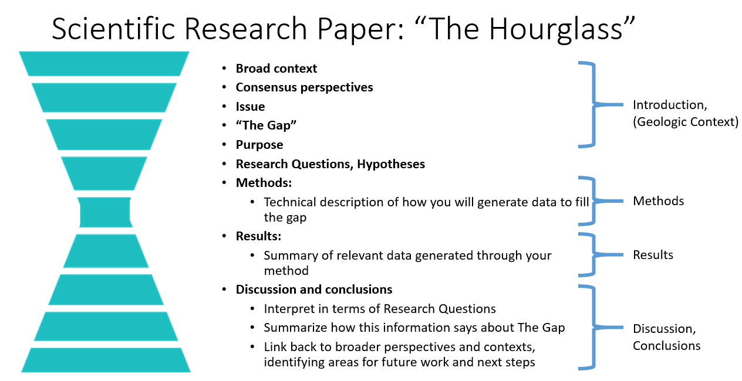

Slide 14
In-Class Activity

Slide 15
Results and Discussion Activity
Use the information from the between-subjects t-test activity from the previous lecture to write up brief results and discussion sections
Include a reference list at the end citing any articles referred to in your results and discussion section (if you refer to any articles)
Use the activity on Blackboard to get started
Write your paper on the document shared with you in Google Docs. Each person should contribute.
Submit your final document on Blackboard. This is a group activity. Only one person needs to submit on Blackboard.

